Slide 1

Compiler Construction
Muhammad awais ali
Department of Computer Science
University of management & technology

Slide 2
Review
So far, we’ve covered the following:
Compilation methods: compilation vs. interpretation.
The overall compilation process.
Front-end analysis
Lexical Analysis
Syntax Analysis
Semantic Analysis
Back-end analysis

Slide 3
Review
Lexical Analysis
Specify valid tokens with regular expressions.
Convert regular expression to a scanner which can recognize the valid tokens.
Use of automatic scanner generators like Lex.
Syntax Analysis
Specify valid patterns of tokens with context-free grammars.
Convert context-free grammar to a parser which can recognize valid strings in the language.
Use of automatic parser generators like Yacc.

Slide 4
Semantic Analysis
Now that we’ve covered the process of validating the structure of a program, now we can discuss the process of validating its meaning.
In general, semantic analysis verifies the portion of the language definition which cannot feasibly be described by a context-free grammar. This includes meaning but also more complicated syntax checks. For example,
Matching the number of arguments of a subroutine to its number of formal parameters. Not nested → cannot be counted by context-free grammars.
Making sure every function has a return statement. Too complex to be feasibly represented by grammar.

Slide 5
Semantic Rules
We can divide semantic rules into two categories.
Static semantic rules.
Enforced at compile-time.
Implemented in semantic analysis phase of the compiler.
Examples include:
Every identifiers has to be declared before use
Type checking/mismatch.
Undeclared variable
Check subroutine call arguments.
Scope Resolution/ Accessing an outside scope of variable

Slide 6
Semantic Rules
Dynamic semantic rules.
Code is generated to enforce at run-time.
Examples include:
Array subscript values are within bounds.
Arithmetic errors.
Pointers are not dereferenced unless pointing to valid object.
A variable is used but hasn't been initialized.

Slide 7
Syntax-Directed Translation
A Syntax-Directed Definition (SDD) is a context-free grammar together with, attributes and rules. Attributes are associated with grammar symbols and rules are associated with productions.
If X is a symbol and a is one of its attributes, then we write X.a to denote the value of a at a particular parse-tree node labeled X.

Slide 8
Attribute Grammars
We’ve discussed in previous lectures how the syntax analysis phase of compilation results in the creation of a parse tree.
Semantic analysis is performed by annotating, or decorating, the parse tree. These annotations are known as attributes.
An attribute grammar “connects” syntax with semantics.

Slide 9
Attribute Grammars
Each grammar production has a semantic rule with actions (e.g. assignments) to modify values of attributes of (non)terminals.
A (non)terminal may have any number of attributes.
Attributes have values that hold information related to the (non)terminal.
General form:
production semantic rule <A> → <B> <C> A.a := ...; B.a := ...; C.a := ...

Slide 10
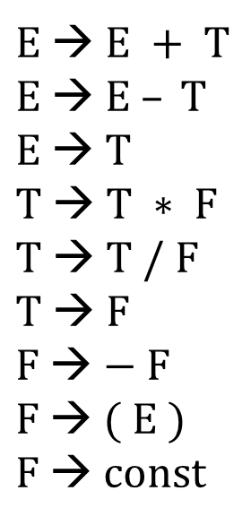
Attribute grammars
First, let’s consider the following LR grammar. It derives strings of arithmetic expressions composed of const values.
$E$ → $E + T$
$E$→ $E – T$
$E$ → $T$
$T$ → $T ∗ F$
$T$ → $T / F$
$T$→ $F$
$F$ → $− F$
$F$→ $( E )$
$F$→ $const$

Slide 11
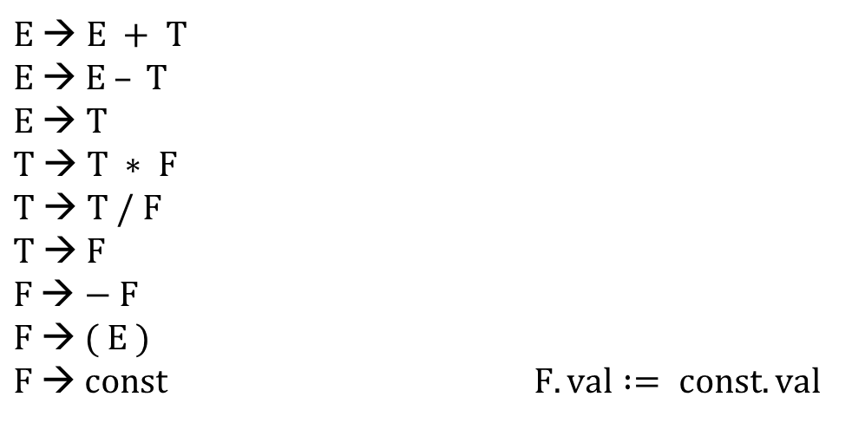
Attribute grammars
Now, let’s add meaning to the productions. We’ll associate a val attribute with E, T, F, and const. The val of const is provided by the scanner as the image of the token.
$E$ → $E + T$
$E$→ $E – T$
$E$ → $T$
$T$ → $T ∗ F$
$T$ → $T / F$
$T$→ $F$
$F$ → $− F$
$F$→ $( E )$
$F$→ $const$ $F.val := const.val$
Every production will only need a single rule in this grammar. We’ll start with the copy rules. These allow us to specify that one attribute should copy the value of another.

Slide 12
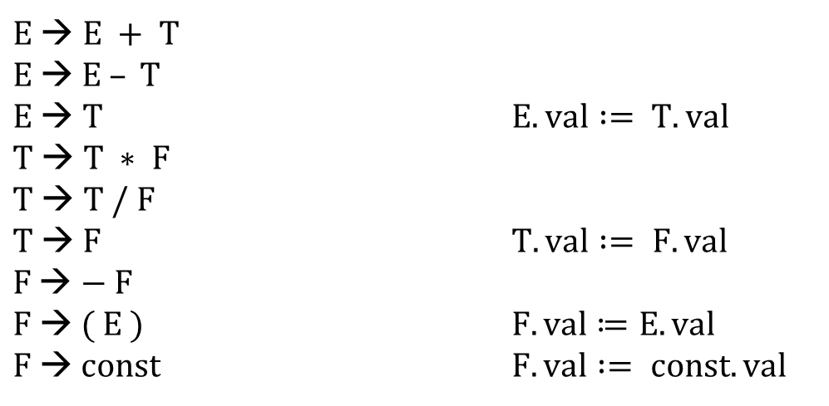
Attribute grammars
Now, let’s add meaning to the productions. We’ll associate a val attribute with E, T, F, and const. The val of const is provided by the scanner as the image of the token.
$E$ → $E + T$
$E$→ $E – T$
$E$ → $T$ $E.val := T.val$
$T$ → $T ∗ F$
$T$ → $T / F$
$T$→ $F$ $T.val := F.val$
$F$ → $− F$
$F$→ $( E )$ $F.val≔E.val$
$F$→ $const$ $F.val := const.val$

Slide 13
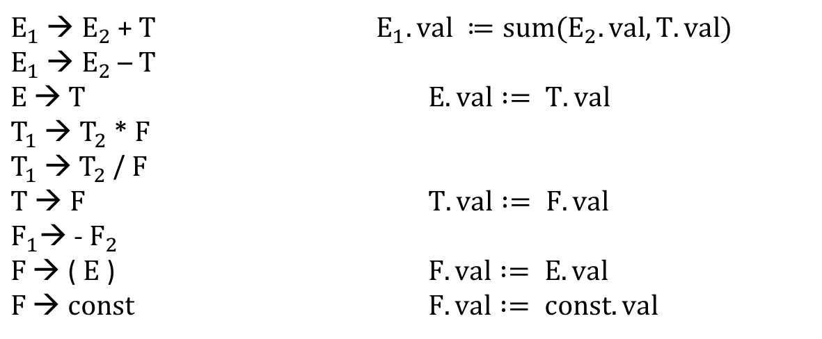
Attribute grammars
Now, let’s add meaning to the productions. We’ll associate a val attribute with E, T, F, and const. The val of const is provided by the scanner as the image of the token.
$E_{1}$ → $E_{2}$ + $T$ $E_{1}.val ≔sum(E_{2}.val, T.val)$
$E_{1}$ → $E_{2}$ – $T$
$E$→ $T$ $E.val := T.val$
$T_{1}$ → $T_{2}$ * $F$
$T_{1}$→ $T_{2}$ /$F$
$T$ → $F$ $T.val := F.val$
$F_{1}$→ - $F_{2}$
$F$ → ( $E$ ) $F.val := E.val$
$F$ → $const$ $F.val := const.val$
Now, we’ll invoke semantic functions which act on attributes and return a value to be stored in another attribute. To avoid ambiguity, we add subscripts to non-terminals.

Slide 14
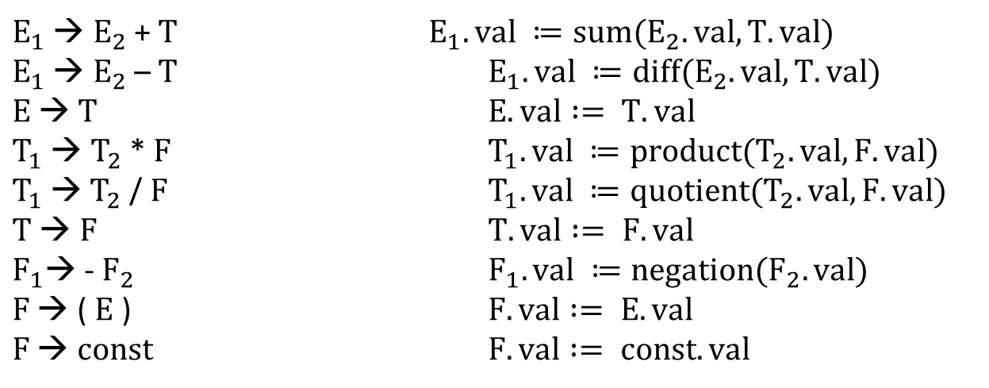
Attribute grammars
Now, let’s add meaning to the productions. We’ll associate a val attribute with E, T, F, and const. The val of const is provided by the scanner as the image of the token.
$E_{1}$ → $E_{2}$ + $T$ $E_{1}.val ≔sum(E_{2}.val, T.val)$
$E_{1}$ → $E_{2}$ – $T$ $E_{1}.val ≔diff(E_{2}.val, T.val)$
$E$→ $T$ $E.val := T.val$
$T_{1}$ → $T_{2}$ * $F$ $T_{1}.val ≔product(T_{2}.val, F.val)$
$T_{1}$→ $T_{2}$ /$F$ $T_{1}.val ≔quotient(T_{2}.val, F.val)$
$T$ → $F$ $T.val := F.val$
$F_{1}$→ - $F_{2}$ $F_{1}.val ≔negation(F_{2}.val)$
$F$ → ( $E$ ) $F.val := E.val$
$F$ → $const$ $F.val := const.val$

Slide 15
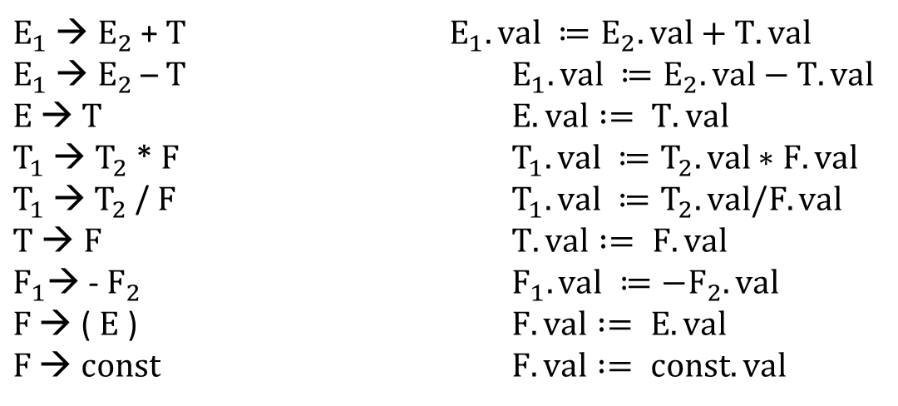
Attribute grammars
Strictly speaking, attribute grammars only consist of copy rules and calls to semantic functions. But in practice, we can specify well-defined notation to make the semantic rules look more code-like.
$E_{1}$ → $E_{2}$ + $T$ $E_{1}.val ≔E_{2}.val+T.val$
$E_{1}$ → $E_{2}$ – $T$ $E_{1}.val ≔E_{2}.val−T.val$
$E$→ $T$ $E.val := T.val$
$T_{1}$ → $T_{2}$ * $F$ $T_{1}.val ≔T_{2}.val∗F.val$
$T_{1}$→ $T_{2}$ /$F$ $T_{1}.val ≔T_{2}.val/F.val$
$T$ → $F$ $T.val := F.val$
$F_{1}$→ - $F_{2}$ $F_{1}.val ≔−F_{2}.val$
$F$ → ( $E$ ) $F.val := E.val$
$F$ → $const$ $F.val := const.val$

Slide 16
Decorated parse trees
E
T
T
*
F
Evaluation of the attributes is called the decoration of the parse tree. Imagine we have the string (1+3)*2. The parse tree is shown here.
F
const
(
E
)
E
+
T
T
F
F
const
const

Slide 17
Decorated parse trees
E
T
T
*
F
Evaluation of the attributes is called the decoration of the parse tree. Imagine we have the string (1+3)*2. The parse tree is shown here. The val attribute of each symbol is shown beside it. Attribute flow is upward in this case.
F
const
2
(
E
)
E
+
T
T
F
F
const
3
const
1

Slide 18
Decorated parse trees
E
T
T
*
F
2
Evaluation of the attributes is called the decoration of the parse tree. Imagine we have the string (1+3)*2. The parse tree is shown here. The val attribute of each symbol is shown beside it. Attribute flow is upward in this case.
F
const
2
(
E
)
E
+
T
T
F
3
F
1
const
3
const
1

Slide 19
Decorated parse trees
E
T
T
*
F
2
Evaluation of the attributes is called the decoration of the parse tree. Imagine we have the string (1+3)*2. The parse tree is shown here. The val attribute of each symbol is shown beside it. Attribute flow is upward in this case.
F
const
2
(
E
)
E
1
+
T
3
T
1
F
3
F
1
const
3
const
1

Slide 20
Decorated parse trees
E
T
T
*
F
2
Evaluation of the attributes is called the decoration of the parse tree. Imagine we have the string (1+3)*2. The parse tree is shown here. The val attribute of each symbol is shown beside it. Attribute flow is upward in this case.
F
const
2
(
E
4
)
E
1
+
T
3
T
1
F
3
F
1
const
3
const
1

Slide 21
Decorated parse trees
E
T
T
4
*
F
2
Evaluation of the attributes is called the decoration of the parse tree. Imagine we have the string (1+3)*2. The parse tree is shown here. The val attribute of each symbol is shown beside it. Attribute flow is upward in this case.
F
4
const
2
(
E
4
)
E
1
+
T
3
T
1
F
3
F
1
const
3
const
1

Slide 22
Decorated parse trees
E
8
T
8
T
4
*
F
2
Evaluation of the attributes is called the decoration of the parse tree. Imagine we have the string (1+3)*2. The parse tree is shown here. The val attribute of each symbol is shown beside it. Attribute flow is upward in this case.
The val of the overall expression is the val of the root.
F
4
const
2
(
E
4
)
E
1
+
T
3
T
1
F
3
F
1
const
3
const
1

Slide 23
Decorated parse trees
E
8
T
8
T
4
*
F
2
The attribute grammar represented is very simple.
All the symbols have at most one attribute.
All the attributes are synthesized -- values calculated only in productions where their symbol is on the left-hand side.
F
4
const
2
(
E
4
)
E
1
+
T
3
T
1
F
3
F
1
const
3
const
1

Slide 24
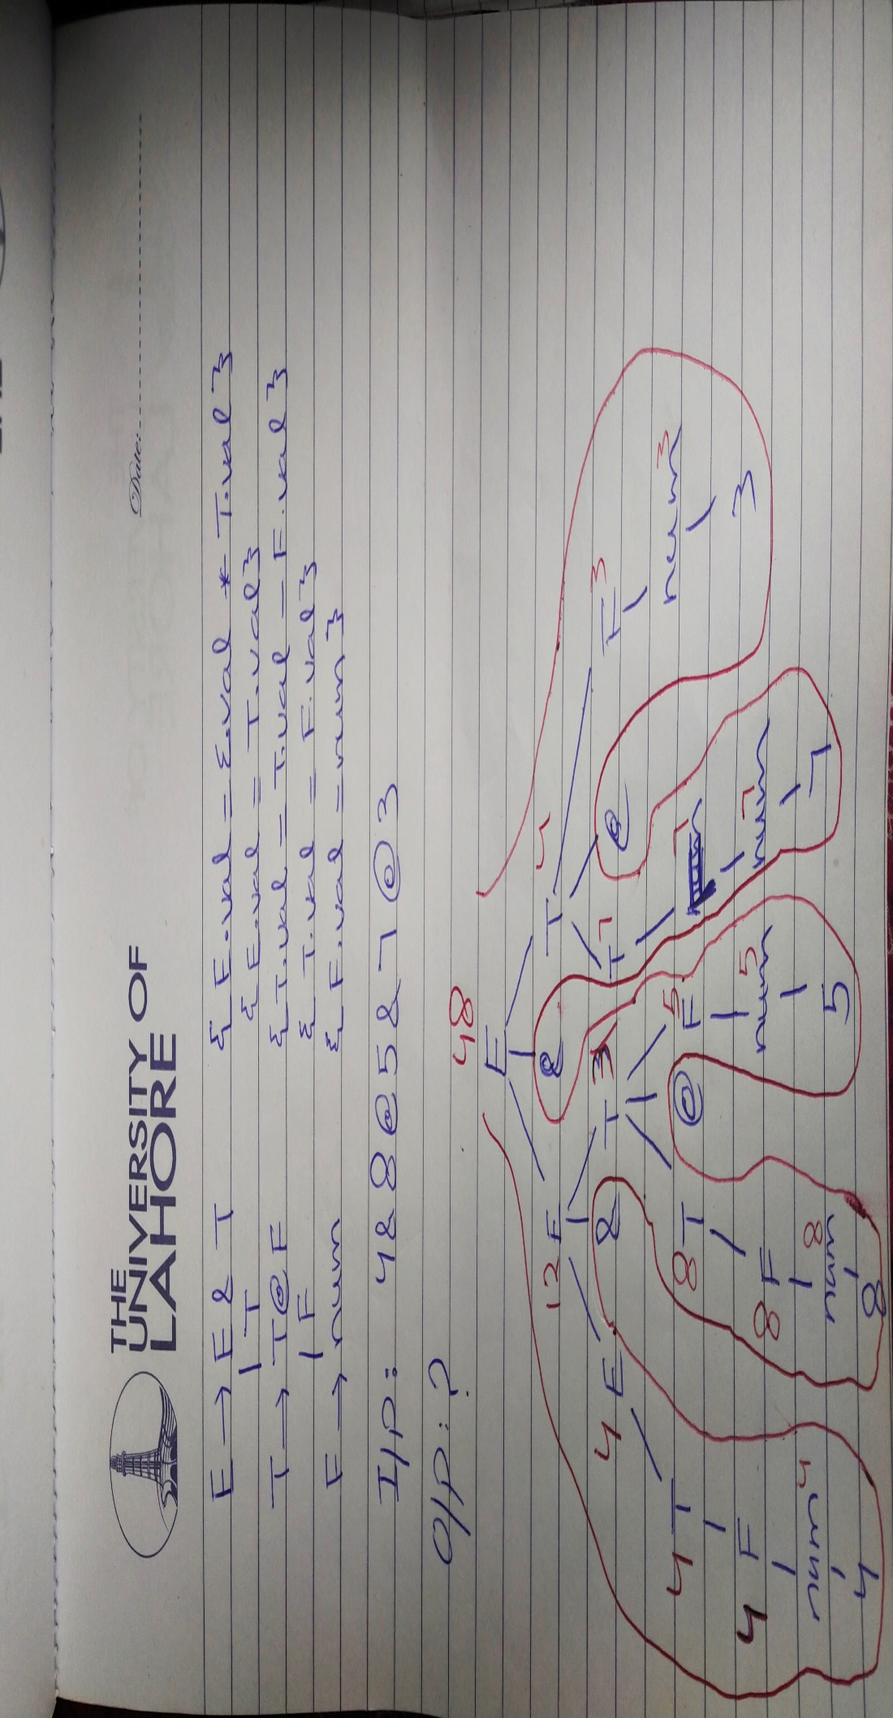

Slide 25
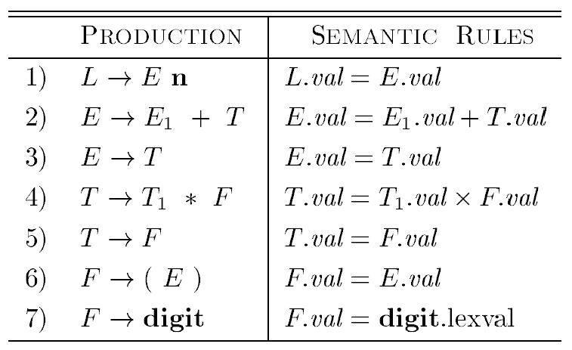
Evaluating an SDD at the Nodes of a Parse Tree
Evaluate an annotated parse tree for the input string 3 * 5 + 4 n, constructed using the grammar and rules

Slide 26
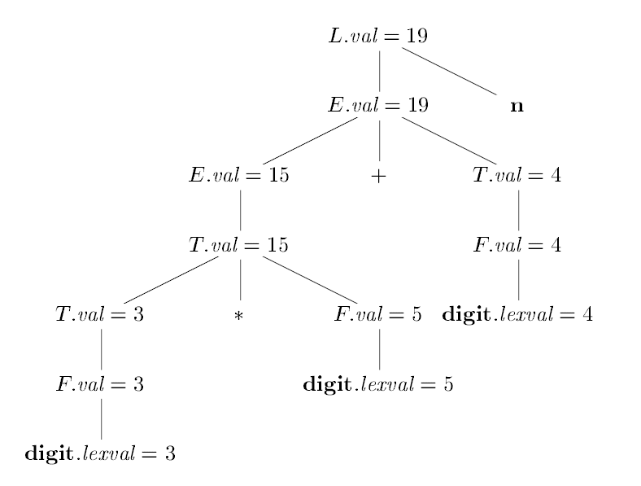
Annotated parse tree

Slide 27
Synthesized attributes
Synthesized attributes of a node hold values that are computed from attribute values of the child nodes in the parse tree and therefore information flows upwards.
production semantic rule E₁ → E₂ + T E₁.val := E₂.val + T.val
E
4
E
1
+
T
3

Slide 28

Inherited attributes
Inherited attributes of child nodes are set by the parent node or sibling nodes and therefore information flows downwards. Consider the following attribute grammar.
$D$ → $T L L.in = T.type$
$T$ → $int T.type = integer$
$T$ → $real T.type = real$
$L$ → $L_{1}, id L_{1}.in = L.in, addtype(id.entry, L.in)$
$L$ → $id addtype(id.entry, L.in)$
real id1, id2, id3

Slide 29

Inherited attributes
$D$ → $T L L.in = T.type$
$T$ → $int T.type = integer$
$T$ → $real T.type = real$
$L$ → $L_{1}, id L_{1}.in = L.in, addtype(id.entry, L.in)$
$L$ → $id addtype(id.entry, L.in)$
D
real
T
L
real
real
L
real
,
id
Notice how L.in is inherited from sibling T.type or from parent L.in.
real
L
,
id
id

Slide 30
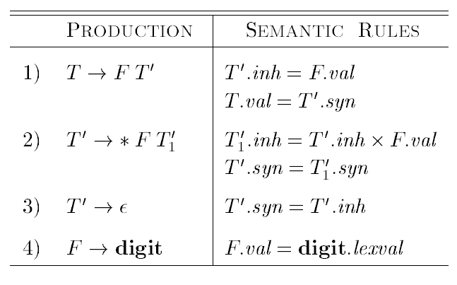
Synthesized and inherited attributes
Here’s an example that exhibits both types of attributes.

Slide 31
Synthesized and inherited attributes
Each of the nonterminals T and F has a synthesized attribute val; the terminal digit has a synthesized attribute lexval.
The nonterminal T' has two attributes: an inherited attribute inh and a synthesized attribute syn.

Slide 32
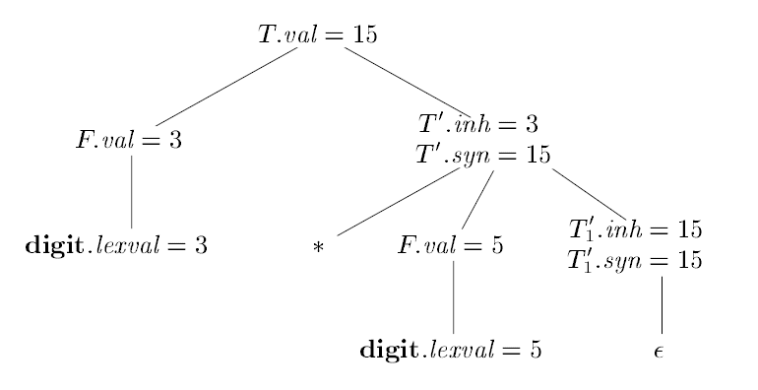
Synthesized and inherited attributes
Annotated parse tree for 3 * 5

Slide 33
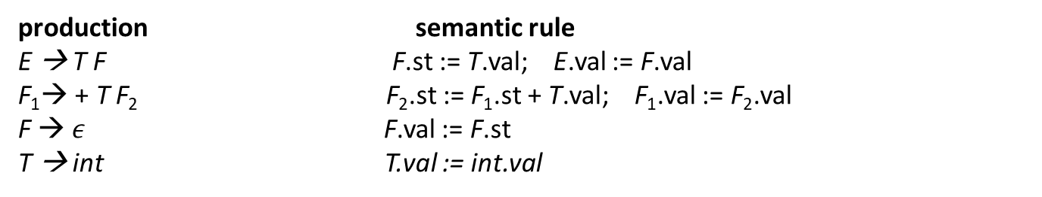
Synthesized and inherited attributes
Here’s an example that exhibits both types of attributes.
production semantic rule
E → T F F.st := T.val; E.val := F.val
F₁→ + T F₂ F₂.st := F₁.st + T.val; F₁.val := F₂.val
F → $ε$ F.val := F.st
T → int T.val := int.val
Example decorated parse tree for 1+3
val
st

Slide 34

Synthesized and inherited attributes
Here’s an example that exhibits both types of attributes.
production semantic rule
E → T F F.st := T.val; E.val := F.val
F₁→ + T F₂ F₂.st := F₁.st + T.val; F₁.val := F₂.val
F → $ε$ F.val := F.st
T → int T.val := int.val
E
4
Example decorated parse tree for 1+3:
T
1
F
1
4
val
int
1
+
T
3
F
4
4
st
int
3
$$ε$$

Slide 35
Attribute flow/Dependency Graph
An attribute flow algorithm propagates attribute values through the parse tree by traversing the tree according to the set (write) and use (read) dependencies (an attribute must be set before it is used).
A dependency graph depicts the flow of information among the attribute instances in a particular parse tree; an edge from one attribute instance to another means that the value of the first is needed to compute the second.

Slide 36


Attribute flow
Consider the previous decorated parse tree.
production semantic rule
E → T F F.st := T.val; E.val := F.val
F₁→ + T F₂ F₂.st := F₁.st + T.val; F₁.val := F₂.val
F → $ε$ F.val := F.st
T → int T.val := int.val
E
T
F
val
int
1
+
T
F
st
int
3
$$ε$$

Slide 37
Attribute flow
Consider the previous decorated parse tree.
production semantic rule
E → T F F.st := T.val; E.val := F.val
F₁→ + T F₂ F₂.st := F₁.st + T.val; F₁.val := F₂.val
F → $ε$ F.val := F.st
T → int T.val := int.val
E
T
1
F
val
int
1
+
T
F
st
int
3
$$ε$$

Slide 38
Attribute flow
Consider the previous decorated parse tree.
production semantic rule
E → T F F.st := T.val; E.val := F.val
F₁→ + T F₂ F₂.st := F₁.st + T.val; F₁.val := F₂.val
F → $ε$ F.val := F.st
T → int T.val := int.val
E
T
1
F
1
val
int
1
+
T
F
st
int
3
$$ε$$

Slide 39
Attribute flow
Consider the previous decorated parse tree.
production semantic rule
E → T F F.st := T.val; E.val := F.val
F₁→ + T F₂ F₂.st := F₁.st + T.val; F₁.val := F₂.val
F → $ε$ F.val := F.st
T → int T.val := int.val
E
T
1
F
1
val
int
1
+
T
3
F
st
int
3
$$ε$$

Slide 40
Attribute flow
Consider the previous decorated parse tree.
production semantic rule
E → T F F.st := T.val; E.val := F.val
F₁→ + T F₂ F₂.st := F₁.st + T.val; F₁.val := F₂.val
F → $ε$ F.val := F.st
T → int T.val := int.val
E
T
1
F
1
val
int
1
+
T
3
F
4
st
int
3
$$ε$$

Slide 41
Attribute flow
Consider the previous decorated parse tree.
production semantic rule
E → T F F.st := T.val; E.val := F.val
F₁→ + T F₂ F₂.st := F₁.st + T.val; F₁.val := F₂.val
F → $ε$ F.val := F.st
T → int T.val := int.val
E
T
1
F
1
val
int
1
+
T
3
F
4
4
st
int
3
$$ε$$

Slide 42
Attribute flow
Consider the previous decorated parse tree.
production semantic rule
E → T F F.st := T.val; E.val := F.val
F₁→ + T F₂ F₂.st := F₁.st + T.val; F₁.val := F₂.val
F → $ε$ F.val := F.st
T → int T.val := int.val
E
T
1
F
1
4
val
int
1
+
T
3
F
4
4
st
int
3
$$ε$$

Slide 43
Attribute flow
Consider the previous decorated parse tree.
production semantic rule
E → T F F.st := T.val; E.val := F.val
F₁→ + T F₂ F₂.st := F₁.st + T.val; F₁.val := F₂.val
F → $ε$ F.val := F.st
T → int T.val := int.val
E
4
T
1
F
1
4
val
int
1
+
T
3
F
4
4
st
int
3
$$ε$$

Slide 44
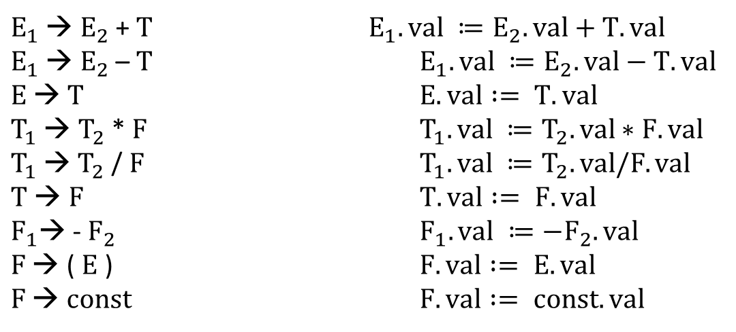
S- and L- Attributed grammars
Synthesized Attributes
A grammar is called S-attributed if all attributes are synthesized. An attribute is said to be Synthesized attribute if its parse tree node value is determined by the attribute value at child nodes.
$E_{1}$ → $E_{2}$ + $T$ $E_{1}.val ≔E_{2}.val+T.val$
$E_{1}$ → $E_{2}$ – $T$ $E_{1}.val ≔E_{2}.val−T.val$
$E$→ $T$ $E.val := T.val$
$T_{1}$ → $T_{2}$ * $F$ $T_{1}.val ≔T_{2}.val∗F.val$
$T_{1}$→ $T_{2}$ /$F$ $T_{1}.val ≔T_{2}.val/F.val$
$T$ → $F$ $T.val := F.val$
$F_{1}$→ - $F_{2}$ $F_{1}.val ≔−F_{2}.val$
$F$ → ( $E$ ) $F.val := E.val$
$F$ → $const$ $F.val := const.val$

Slide 45
S- and L- Attributed grammars
Synthesized Attributes
It can be evaluated during a single bottom-up traversal of parse tree
A synthesized attribute at node n is defined only in terms of attribute values at the children of n itself.
The production must have non-terminal as its head.

Slide 46
S- and L- Attributed grammars
Inherited Attributes
An attribute is said to be Inherited attribute if its parse tree node value is determined by the attribute value at parent and/or siblings node.
The production must have non-terminal as a symbol in its body
A Inherited attribute at node n is defined only in terms of attribute values of n’s parent, n itself, and n’s siblings.
It can be evaluated during a single top-down and sideways traversal of parse tree.

Slide 47
S- and L- Attributed grammars
Inherited Attributes
D
real
T
L
real
real
L
real
,
id
real
L
,
id
id

